Slide 1



l'IL-23/ IL-12 MoA + Le choix du premier traitement biologique MC
©Janssen-Cilag NV - CP-237680 – 3-jui-2021 - vu/er Luc Van Oevelen, Antwerpseweg 15-17, 2340 Beerse
Prof. Edouard Louis
Head of the department of Gastroenterology University Hospital CHU of Liège Belgium
MC: maladie de Crohn

Slide 2
Disclosures
Has a financial interest/relationship or affiliation in the form of: Grant/Research Support from:
Research grant: Takeda, Pfizer
Educational grant: AbbVie, MSD, Takeda, Janssen
Speaker fees: AbbVie, Ferring, MSD, Chiesi, Falk, Takeda, Hospira, Janssen, Pfizer
Advisory board: AbbVie, Ferring, MSD, Takeda, Celltrion, Celgene, Hospira, Janssen, Pfizer
Consultant: AbbVie
Edouard Louis
CP-237680
ezaeaze

Slide 3
Pourquoi l'IL-23/ IL-12 est une cible importante pour le traitement des MICI aujourd’hui et demain
Edouard Louis

Slide 4
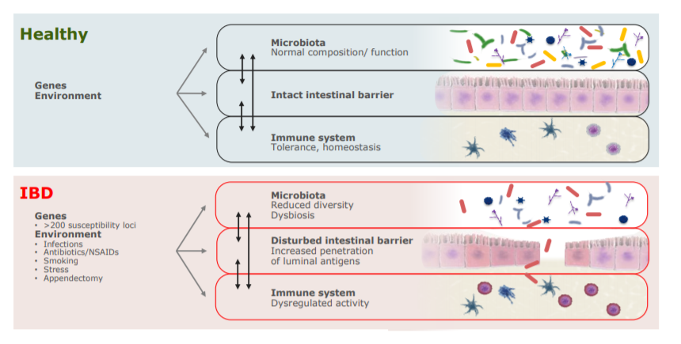
Rutpure de l’homéostasie intestinale dans les MICI
CP-237680
Neurath MF. Nat Immunol. 2019 Aug;20(8):970-979; de Lange et al. Nat Genet. 2017 Feb;49(2):256-261.

Slide 5
Variations génétiques majeures détectées par GWAs dans les MICI
Chr
Gène
Fonction
CD
UC
1p31
IL-23 receptor
Immune inflammatory response
+
+
5q33
IL-12b (p40)
Immune inflammatory response
+
+
9p24
JAK2
Signaling molecules
+
+
17q21
STAT3
Transcription factor
+
+
18p11
PTPN2
T cell tyrosine phosphatase
+
-
9q32
TNFS15
Immune inflammatory response
+
-
6q27
CCR6
Chemokine receptor
+
-
3p21
MST1
Macrophage chemotaxis
+
-
2q37
ATG16L1
Autophagosome pathway
+
-
5q33
IRGM
Autophagosome pathway
+
-
16q12
NOD2/CARD15
Bacterial recognition
+
-
20q13
TNFRSF6B
Inflammatory response, apoptosis
+
+
CP-237680
21q22
PSMG1
Proteasome-related protein
+
+
5p13
PTGER4
Barrier function, immunoregulation
+
-
12q12
MUC19
Epithelial integrity
-
+
1q32
IL-10
Immunoregulation
-
+
Resequencing of positional candidates identifies low frequency IL23R coding variants protecting against inflammatory bowel disease. Momozawa Y, Nat Genet. 2011 Jan;43(1):43-7.
Genome-wide association defines more than 30 distinct susceptibility loci for Crohn’s disease. JC Barrett, Nat Genet. 2008;40:955-62.
Notes:
5

Slide 6
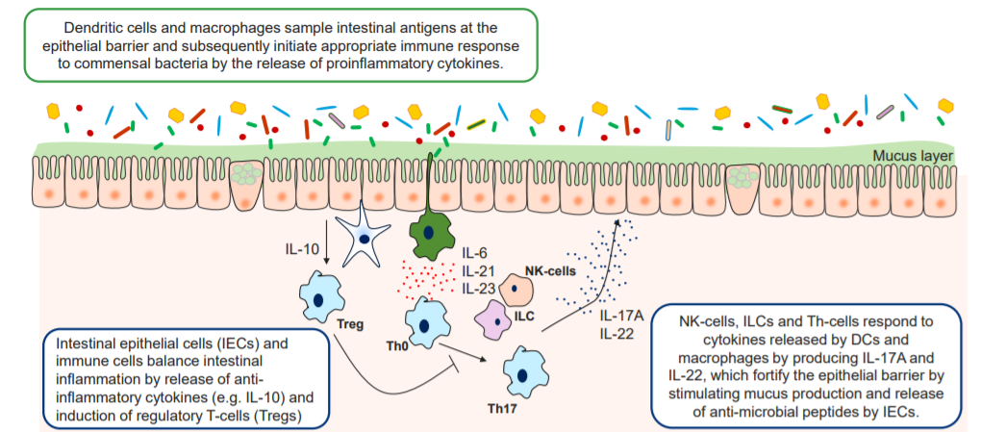
De l’inflammation « physiologique »…
CP-237680
ILC: Innate lymphoid cells; IEC: Intestinal epithelial cells; IL: Interleukin; NK: Natural killer; Th: T helper cell; Treg: Regulatory T-cell
Flannigan et al. Am J Pathol. 2015;185:1809–1819; Stagg. Front Immunol. 2018;9:2883.; Schreiber et al. J Mol Biol. 2015;427:3676-82; Andrews et al. Front Immunol. 2018;9:1270.

Slide 7
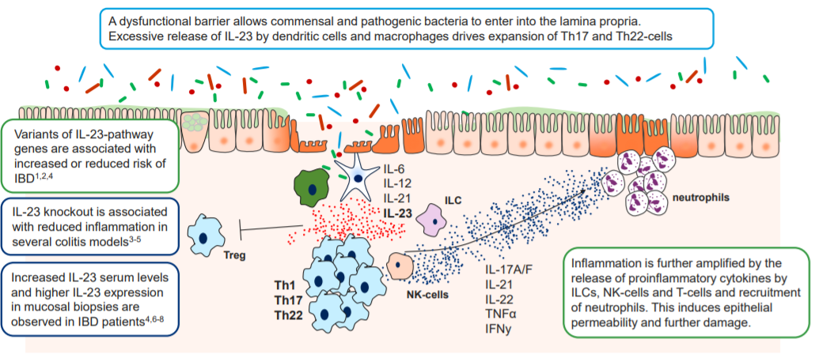
…à l’inflammation pathologique
CP-237680
ILC: Innate lymphoid cells; IL: Interleukin; NK: Natural killer; Th: T helper cell; TNF; Tumor necrosis factor; IFN: Interferon: Treg: Regulatory T-cell 1Jostins et al. Nature 2012;491;119-2; 2Naser et al. World J Gastroenterol. 2012;18:412–424.3Hue et al. J Exp Med. 2006;203:2473-83. 4Neurath et al. Cytokine Growth Factor Rev. 2019;45:1-8.5Imamura et al. Eur J Pharmacol. 2018;824:163-169. 6Geitha et al. Clin Rheumatol. 2014;33:713-7. 7Schmidt et al. Inflamm Bowel Dis. 2005;11:16-23. 8Zhu et al. Pharmazie 2017;72:283-7. 8Liu et al. J Leukoc Biol. 2011;89:597-606.9Mucosal Immunol. 2008;1:339-49. 10Aggeletopoulou. World J Gastroenterol. 2018;24:4093–4103.

Slide 8
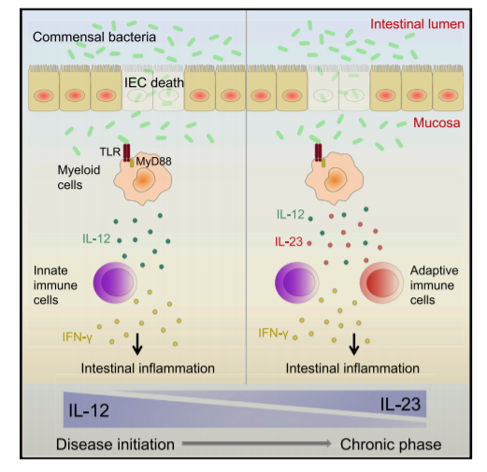
IL-12 et IL-23 pourraient intervenir à différentes phase de l’inflammations intestinale
CP-237680
Eftychi et al., 2019, Immunity 51, 367–380

Slide 9
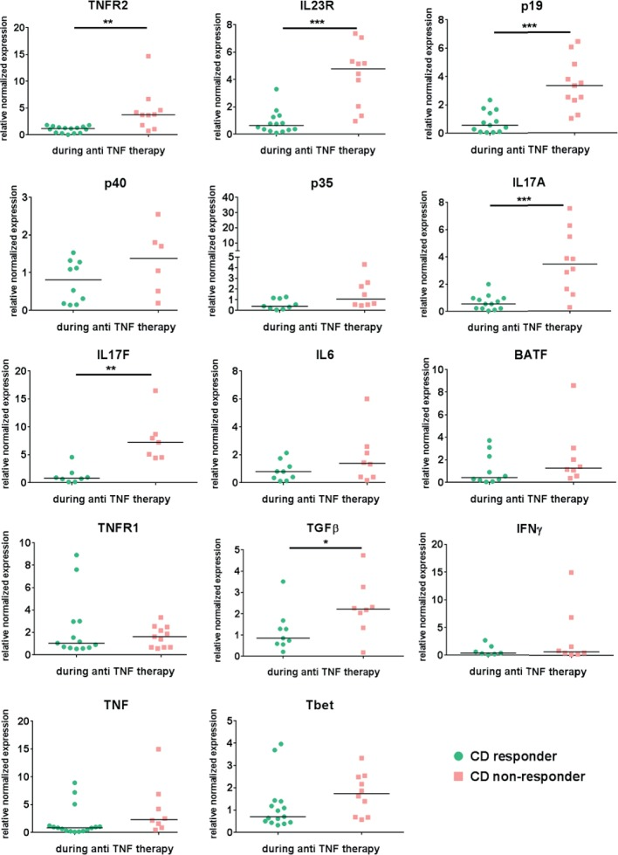
Expansion of IL-23 receptor bearing TNFR2+ T cells is associated with molecular resistance to anti-TNF therapy in Crohn's disease
CP-237680
Schmitt et al. Gut. 2019 May;68(5):814-828
Notes:
Gut. 2019 May;68(5):814-828. doi: 10.1136/gutjnl-2017-315671. Epub 2018 May 30.
Expansion of IL-23 receptor bearing TNFR2+ T cells is associated with molecular resistance to anti-TNF therapy in Crohn's disease.
Schmitt H¹, Billmeier U¹, Dieterich W¹, Rath T¹, Sonnewald S², Reid S², Hirschmann S¹, Hildner K¹, Waldner MJ¹, Mudter J³, Hartmann A⁴, Grützmann R⁵, Neufert C¹, Münster T⁶, Neurath MF¹, Atreya R¹.
Author information
1First Department of Medicine, Friedrich-Alexander-University Erlangen-Nürnberg, Erlangen, Germany.2Department of Biology, Friedrich-Alexander-University Erlangen-Nürnberg, Erlangen, Germany.3Sana Clinic Ostholstein, Eutin, Germany.4Department of Pathology, Friedrich-Alexander-University Erlangen-Nürnberg, Erlangen, Germany.5Department of Surgery, Friedrich-Alexander-University Erlangen-Nürnberg, Erlangen, Germany.6Department of Anesthesiology, Friedrich-Alexander-University Erlangen-Nürnberg, Erlangen, Germany.
Abstract
OBJECTIVE:
Anti-tumour necrosis factor (TNF) antibodies are successfully used for treatment of Crohn's disease. Nevertheless, approximately 40% of patients display failure to anti-TNF therapy. Here, we characterised molecular mechanisms that are associated with endoscopic resistance to anti-TNF therapy.
DESIGN:
Mucosal and blood cells were isolated from patients with Crohn's disease prior and during anti-TNF therapy. Cytokine profiles, cell surface markers, signalling proteins and cell apoptosis were assessed by microarray, immunohistochemistry, qPCR, ELISA, whole organ cultures and FACS.
RESULTS:
Responders to anti-TNF therapy displayed a significantly higher expression of TNF receptor 2 (TNFR2) but not IL23R on T cells than non-responders prior to anti-TNF therapy. During anti-TNF therapy, there was a significant upregulation of mucosal IL-23p19, IL23R and IL-17A in anti-TNF non-responders but not in responders. Apoptosis-resistant TNFR2+IL23R+ T cells were significantly expanded in anti-TNF non-responders compared with responders, expressed the gut tropic integrins α4β7, and exhibited increased expression of IFN-γ, T-bet, IL-17A and RORγt compared with TNFR2+IL23R- cells, indicating a mixed Th1/Th17-like phenotype. Intestinal TNFR2+IL23R+ T cells were activated by IL-23 derived from CD14+ macrophages, which were significantly more present in non-responders prior to anti-TNF treatment. Administration of IL-23 to anti-TNF-treated mucosal organ cultures led to the expansion of CD4+IL23R+TNFR2+ lymphocytes. Functional studies demonstrated that anti-TNF-induced apoptosis in mucosal T cells is abrogated by IL-23.
CONCLUSIONS:
Expansion of apoptosis-resistant intestinal TNFR2+IL23R+ T cells is associated with resistance to anti-TNF therapy in Crohn's disease. These findings identify IL-23 as a suitable molecular target in patients with Crohn's disease refractory to anti-TNF therapy.
© Article author(s) (or their employer(s) unless otherwise stated in the text of the article) 2019. All rights reserved. No commercial use is permitted unless otherwise expressly granted.

Slide 10
IL23: un pathway commun à plusieurs IMID
PsA
PsA affects ∼24% of PsO patients²⁰
Psoriasis
IBD
CD
UC
IL-23
Arthritis occurs in ∼30% of IBD patients²¹
The risk of IBD is increased in patients who have PsO with concominant PsA¹⁷⁻¹⁹
The risk of PsO is significantly increased in both UC and CD^{14-16,19}
CP-237680
CD, Crohn’s disease; IBD, inflammatory bowel disease; IL, interleukin; PsA, psoriatic arthritis; UC, ulcerative colitis. 1. Elewaut D. PLoS Genet 2010;6:e1001223. 2. Veale DJ and Fearon U. RMD Open 2015;1:e000025. 3. Croxford AL et al. Eur J Immunol 2012;42:2263–2273. 4. Lories RJ and McInnes IB. Nature Medicine 2012;18:1018–1019. 5. Sherlock JP et al. Nat Med 2012;18:1069–1076. 6. Gyires K et al. Curr Pharm Des 2014;20:1063–1081. 7. Chiricozzi A et al. Expert Opin Ther Targets 2014;18:513–525. 8. Frleta M et al. Curr Rheumatol Rep 2014;16:414. 9. Melmed GY and Targan SR. Nat Rev Gastroenterol Hepatol 2010;7:110–117. 10. Wallace KL et al. World J Gastroenterol 2014:20:6–21. 11. Ciccia F et al. Arthritis Rheum 2009;60:955–965. 12. Jethwa H and Bowness P. Clin Exp Immunol 2016;183:30–36. 13. Puig L. Expert Rev Clin Immunol 2017;13:525-534; 14. Bernstein CN et al. Gastroenterology. 2005;129(3):827-36. 15. Lee FI et al. Am J Gastroenterol. 1990;85(8):962-3. 16, Yates VM et al. Br J Dermatol. 1982;106(3):323-30. 17. Li WQ et al. Ann Rheum Dis 2013;72(7):1200–1205. 18: Eppinga et al. Inflamm Bowel Dis. 2017;23(10):1783-1789. 19: Egeberg et al. Br J Dermatol. 2016;175(3):487-92. 20: Puzenat et al. J Eur Acad Dermatol Venereol. 2010;24 Suppl 2:31-5. 21. Arvikar SL, et al. Curr Rev MusculoskelMed.2011;4(3):123-131.

Slide 11
Possible effects of dietary factors on host barrier and immunity leading to IBD
High Fat High Sugar Diet
Emulsifiers
Low Fiber
Low Fiber
High Fat
Gluten
Tregs
Cathelicidins
Defensins
Mucous Layer
Goblet Cells
Emulsifiers
Carrageenans
Gluten
High Fat Diet
Alcohol
Intestinal
Permeability
Intracellular
Bacterial clearance
High Fat Diet
Maltodextrins
CP-237680
Lewis JD et al. Gastroenterology 2017;152:398–414

Slide 12
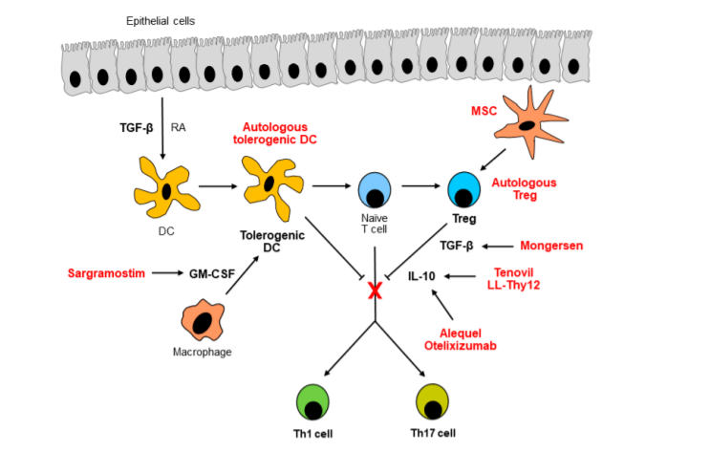
Restauration des voies anti-inflammatoires endogènes
CP-237680
Giufridda et al. Cells. 2019 Apr 30;8(5):397. doi: 10.3390/cells8050397.

Slide 13
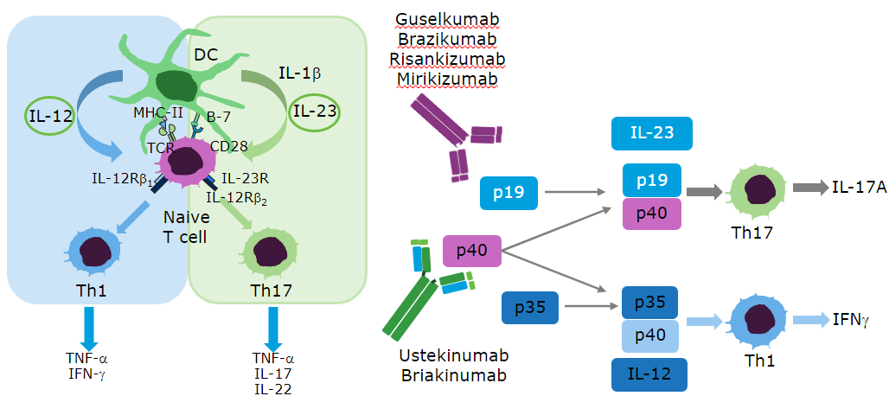
Targeting T-cell differentiation in ulcerative colitis and Crohn’s disease
CP-237680
CD, cluster of differentiation; DC, dendritic cell; IFN, interferon; MHC, major histocompatibility complex; T-cell receptor; Th, T helper.
Gately MK, et al. Annu Rev Immunol. 1998; 16:495-521.
Wilson NJ, et al. Nat Immunol. 2007;8:950-7.
Teng MWL, et al. Nat Med. 2015;21:719-29.

Slide 14
Conclusions
Les MICI se caractérisent par une précarité de l’homéostasie intestinale
Les voies de l’IL-12 et de l’IL-23 sont centrales dans la pathogénèse des IMID, en particulier des MICI
La modulation des voies de l’IL-12 et de l’IL-23 représentents une voie importante de traitement des MICI
CP-237680

Slide 15
Le choix du premier traitement biologique: un reel impact pour des résultats optimaux à long terme chez les patients atteints de la maladie de Crohn?
Edouard Louis

Slide 16
Available treatments for IBD
(June 2021)
Treatment for CD
  (5ASA)
  Steroids
  (Purines)
  (Methotrexate)
  Infliximab
  Adalimumab
  Vedolizumab
  Ustekinumab
  Anti-p19 (IL-23)
  JAK-inhib
  S1P1 inhibitors
  Etrolizumab
  …
Treatment for UC
  5ASA
  Steroids
  (Purines)
  Infliximab
  Adalimumab
  Golimumab
  Vedolizumab
  Tofacitinib
  Ustekinumab
  Anti-p19 (IL-23)
  Selective JAK-inhib
  S1P1 inhibitors
  Etrolizumab
  Ontamalimab
  …
CP-237680

Slide 17





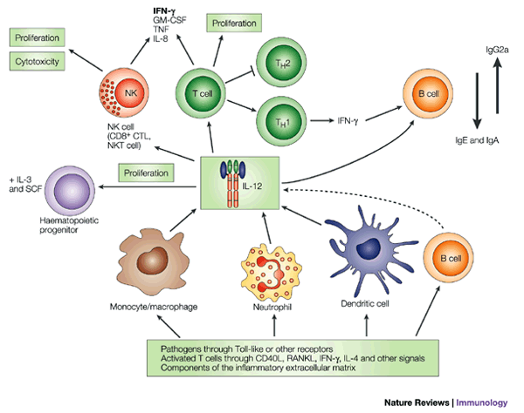

MOAs of anti-trafficking and anti-cytokine drugs
Anti-α4β7
Anti-TNFs
Anti-IL12/23
Gut-selective
Systemic
Systemic
T cells
T cells
T cells
B cells
B cells
B cells
Monocytes
NK cells
....
TNF-a
Osteoclasts
IL-12/23
Haematop.
progenitor
Blood vessel
Gut
....
Vedolizumab
Infliximab, adalimumab, golimumab
Ustekinumab
A subset of immune cells display the α4β7 integrin on the surface, which allows trafficking into the gut.
Vedolizumab binds α4β7 integrin and selectively blocks migration of these cells into the gut,¹ which prevents them from driving inflammation locally.
TNF-alpha has many downstream targets² and is involved in multiple cellular processes, including metabolism, angiogenesis, and immuno-activation.
Anti-TNFs inhibit all of these processes on a systemic level, explaining the high risk for adverse events and infections.
IL-12 and IL-23 are involved in the
long-term protection from pathogens³ through activation of multiple cell types. IL-12 is also implicated in osteogenesis and proliferation of hematopoietic progenitors.
Ustekinumab binds to and blocks both IL-12 and IL-23 systemically.
CP-237680
IL, interleukin; MOAs, mechanisms of action; TNF, tumor necrosis factor.
1. Soler D et al. J Pharmacol Exp Ther 2009;330:864–875. 2. Esposito E et al. Trends Pharmacol Sci 2011;32:107–115. 3. Trinchieri G. Nat Rev Immunol 2003;3:133–146.

Slide 18

Optimal treatment choice to reach the target
CP-237680

Slide 19
How to choose?
Patient molecular profile/ Drug companion marker
Comparative efficacy on gut healing
  Disease location
  Disease behaviour
  Type and extent of lesions
Comparative efficacy on Patients Reported outcomes
  Intestinal symptoms
  Extra-intestinal manifestations
  General well-being
Comparative safety and tolerance
Patient preference/way of life
Precision Medicine
Ability to reach the Target
Safety and Patient priorities
CP-237680

Slide 20
Patient preferences for IBD treatment
Efficacy
  Abdominal pain
  Other disease-related pain
  Bowel urgency (When you feel the need for a bowel movement you have to rush to the toilet to avoid an accident)
  Fatigue (An overwhelming sense of continuing tiredness, lack of energy or feeling exhausted that is not relieved by rest or sleep)
Complications/Risk
  Risk of cancer and serious infections within the next 10 years
  Risk of mild to moderate side-effects (nausea, vomiting, headache, non-serious infections, lab abnormalities, skin reactions, infusion reactions…)
  Aesthetic complications related to Treatment (Hair loss, unintentional weight change, facial hair, acne, puffy face)
Health-related quality of life
  Emotional status
  Sexual life
  Social life and relationships (Interpersonal interactions)
CP-237680
Defining Meaningful Attributes for the Treatment of Inflammatory Bowel Diseases from Patients’ Perspective. Louis E et al, UEGW 2019

Slide 21
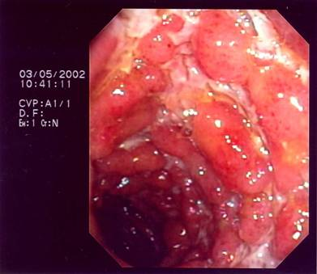
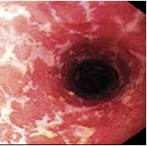
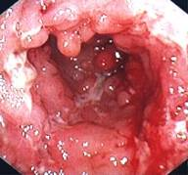
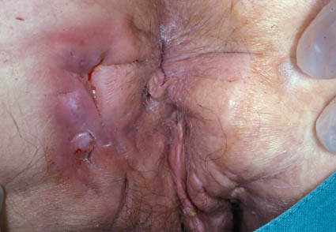
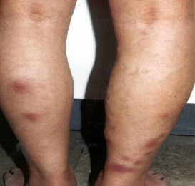
Disease/Patient
Extent
Perianal dis. / fistulas
General Physical Condition / impact on daily life
Phenotype
Severity
Sclerosing cholangitis
cardiac
Multiple sclerosis
Cancer
Obesity
…
Co-morbidities
Treatment
Mono therapy
Mono
+ IS, +CS,
EIM
Skin
Joints (periph. vs. axial)
Eyes
Patient preference
IV versus SC
Interval between administrations
Adherence
Side effects
Infections
Paradoxical reaction
Allergies
…
Flexible dose
Long term efficacy
Treatment optimisation
Modify dose, interval, re-induction…
Speed of Action
Mucosal healing
Secondary loss of response vs sustained
CP-237680
Price
Lichtenstein et al. Am J Gastroenterol 2018; 113:481-517; doi:10.10.1038/ajg.2018.27; published online 27 March 2018

Slide 22
Comment l’ustekinumab répond aux attentes d’un premier biologique dans la MC
Capacité à atteindre la cible
Sécurité et tolérance
Qualité de vie et capacité de vivre la vie souhaitée
CP-237680

Slide 23
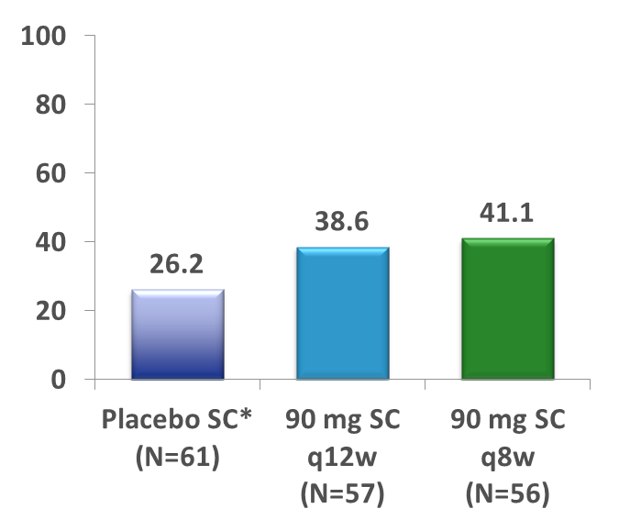
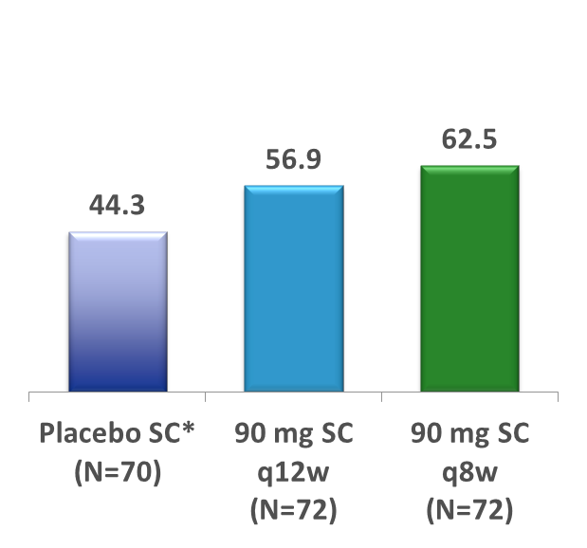
Clinical Remission at Week 44 in Anti-TNF Failure & in Anti-TNF-naïve Subjects
IM-UNITI
Overall IM-UNITI Population (delta’s vs. Pbo): 12.9% q12w, 17.2% q8w
UNITI-1
UNITI-2
(anti-TNF Failure)
(Conv. Failure)
p=0.146
p=0.02
Δ 12.6%
Δ 18.2%
p=0.140
p=0.102
Δ 12.4%
Δ 14.9%
Proportion of Subjects (%)
CP-237680
Ustekinumab
Ustekinumab
*Subjects who were in clinical response to ustekinumab IV induction dosing and were randomized to placebo SC on entry to this maintenance study
Feagan B.G. et al. Ustekinumab as Induction and Maintenance Therapy for Crohn's Disease, N Engl J Med 2016;375:1946-60
Notes:
TEFCREM08: Number of subjects in clinical remission at Week 44

Slide 24
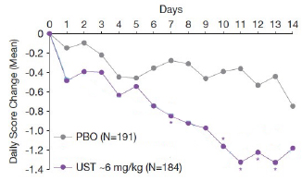
Changement moyen du nombre quotidien de selles liquides dans les jours qui suivent l’induction IV par ustekinumab
IV UST induced significant improvements in SF within the first 2 weeks
Mean improvement in SF was significantly better than placebo on Day 7
CP-237680
*p<0.05 for UST ~6 mg/kg vs. placebo
Sandborn WJ. UEGW 2017

Slide 25
Proportion of bio-naïve patients in the real-life ustekinumab cohorts
0%
0%
0%
4.8%
0%
4.7%
1.4%
0%
CP-237680
Khorammi S et al. Inflamm Bowel Dis 2016; 22:16621669
Battat R et al. JCC volume 11, issue suppl_1, 1 2017. S400-S401
Greenup A et al. ECCO 2017. P625.
Wils P, et al. Aliment Pharmacol Ther. 2018;1-8; doi:10.1111/apt.14487
Verstockt et al. JCC ECCO 2019. Manuscript doi:10.1093/ecco-jcc/jjz008
Biemans VBC et al. ECCO 2019. Manuscript doi:10.1093/ecco-jcc/jjz119
Liefferinckx C et al. ECCO 2019. Manuscript doi:10.1093/ecco-jcc/jjz080

Slide 26
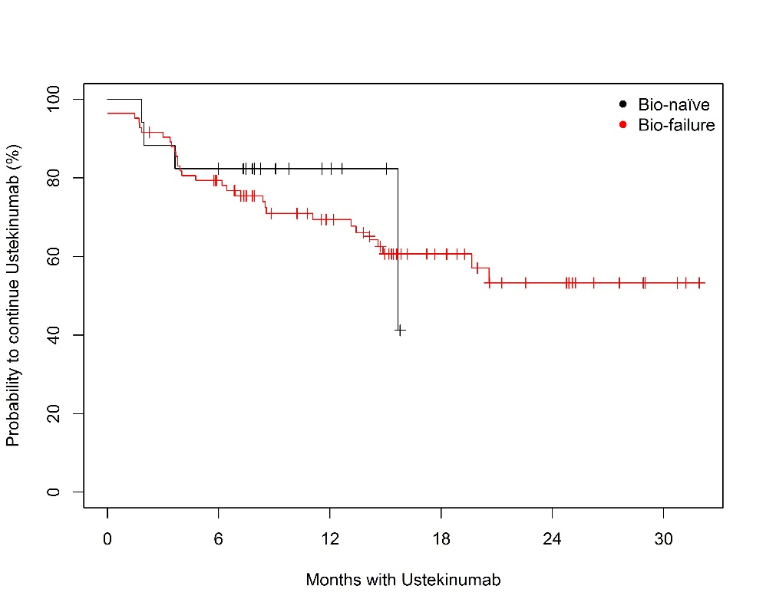
Long term Ustekinumab treatment persistence in Bio-naïve and Bio-failure CD patients
Monocentric real-life cohort of patients including 28/143 bio-naive patients
CP-237680
Monin et al. BWG 2020

Slide 27
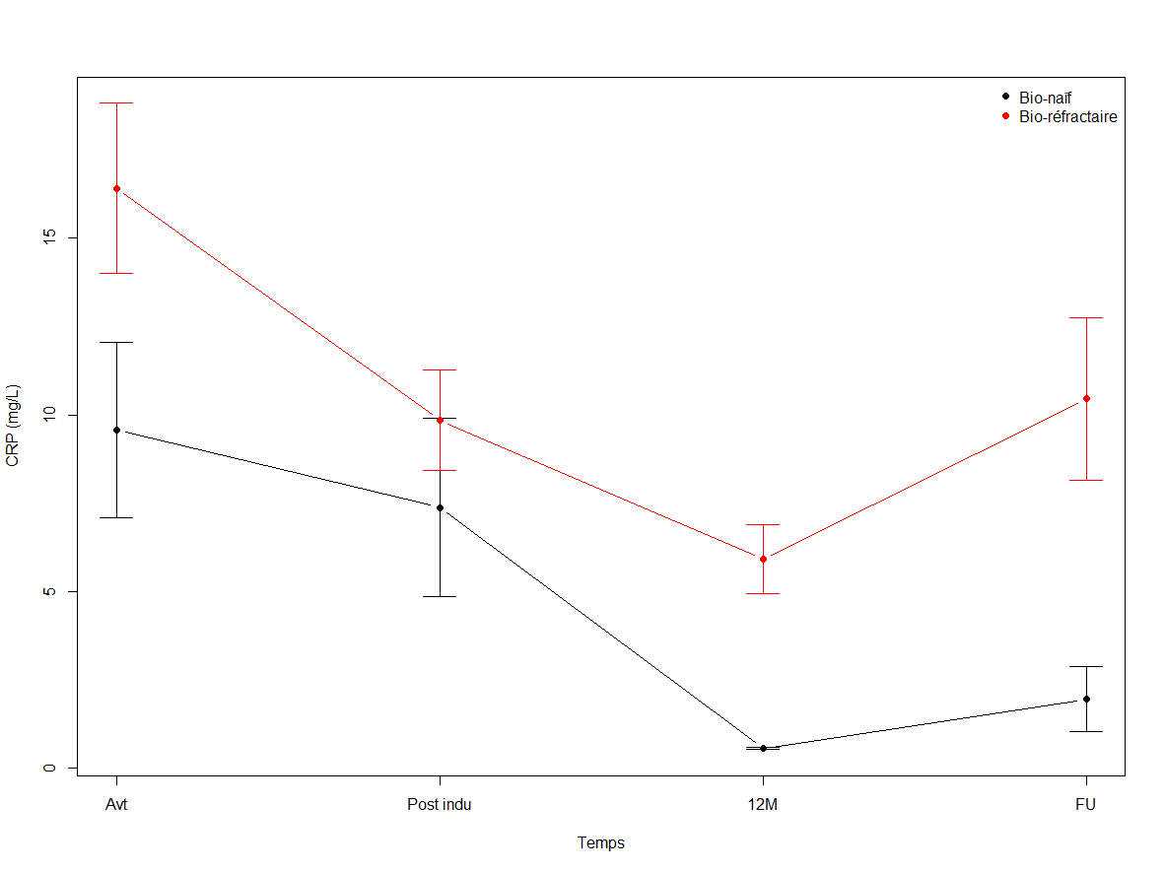
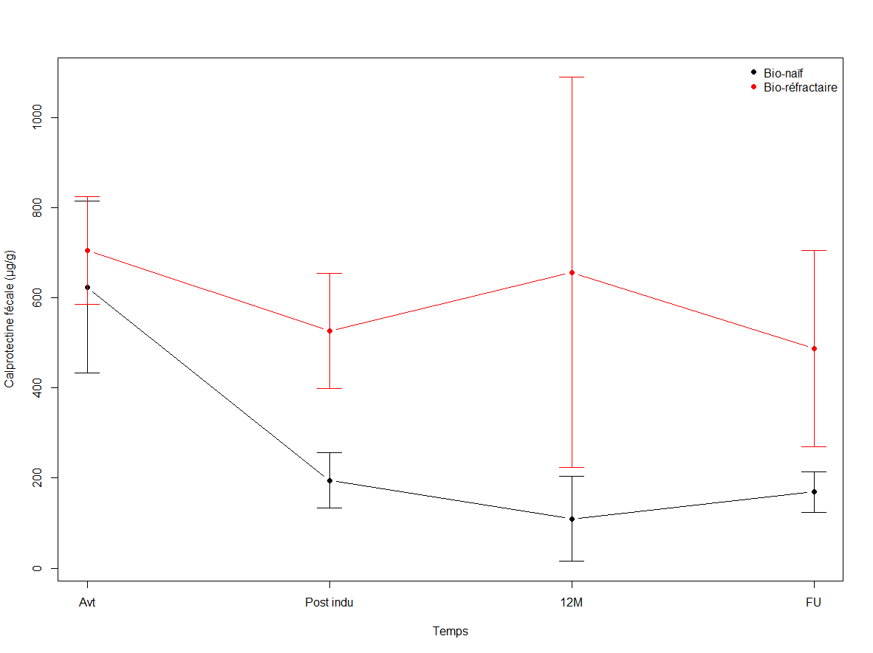
CRP and fecal calprotectin evolution during Ustekinumab treatment in Bio-naïve and Bio-failure CD patients
Monocentric real-life cohort of patients including 28/143 bio-naive patients
CP-237680
Monin et al 2020

Slide 28
STARDUST: Demographics, baseline clinical characteristics and patient disposition (FAS)
 | FAS (n=500)
Age, years, mean (SD) | 37.0 (12.9)
Sex, n (%)
Female | 257 (51.4)
Male | 243 (48.6)
Body mass index, kg/m², mean (SD) | 23.8 (4.7)
Time from diagnosis to first study drug administration, years, mean (SD) | 9.4 (8.7)
CDAI score, mean (SD) | 282.3 (65.8)
SES-CD score, mean (SD) | 13.1 (8.1)
CRP, mg/L, mean (SD) | 15.7 (23.4)
FCal, µg/g, mean (SD) | 1741.9 (2932.1)
Prior exposure to biologics, n (%)
Biologic naïve | 208 (41.6)
Prior exposure to 1 biologic* | 292 (58.4)
Location of disease, n (%)
N | 467
Ileal | 123 (26.3)
Colonic | 168 (36.0)
Ileocolonic | 176 (37.7)
Patients with ≥ 1 concomitant medication, n (%) | 459 (91.8)
Systemic corticosteroids not incl. budesonide | 116 (23.2)
Budesonide | 51 (10.2)
Immunosuppressants | 119 (23.8)
Assessment for eligibility (n=680)
Screening failures and other reasons for not being included in study (n=180)
Week 0: UST ~6 mg/kg IV (FAS; n=500)
Discontinued during first 16 weeks (n=10)
Adverse event (n=5)
Withdrawal of consent (n=3)
Physician decision (n=1)
Progressive disease (n=1)
Week 8: UST 90 mg SC
Completed Week 16: Assessed for CDAI 70 response (n=490)
Did not achieve CDAI 70 response - withdrawn from trial (n=43)
Lack of efficacy (n=2)
Adverse event (n=1)
Pregnancy (n=1)
Withdrawal of consent (n=1)
Personal reasons (n=1)
Achieved CDAI 70 response and underwent randomization (1:1) (n=441)
88.2%
CP-237680
Randomized T2T arm (n=220)
SoC arm (n=221)
©ECCO 2020 Vienna Congress – Speaker: Danese et al. abstract presentation DOP13, ECCO 2020
*77.5% of patients with prior exposure to 1 biologic experienced treatment failure; 22.5% others.
CDAI, Crohn’s Disease Activity Index; FAS, full analysis set (all enrolled patients who received at least 1 dose of study agent); IV, intravenous; RoC, routine care; SC, subcutaneous; SD, standard deviation; SES-CD, Simple Endoscopic Score for Crohn’s Disease; T2T, treat-to-target; UST, ustekinumab

Slide 29
Clinical remission and response
Overall and by prior exposure to biologic treatment (FAS)
CP-237680
All patients (N=500)
Biologic naïve (n=208)
Prior exposure to 1 biologic (n=292)*
At Weeks 8 and 16, respectively, 83.0% and 83.9% of patients in clinical response were also in clinical remission
©ECCO 2020 Vienna Congress – Speaker: Danese et al. abstract presentation DOP13, ECCO 2020
N=500. Clinical remission was defined as a CDAI Total score of <150 points. Clinical response (CDAI 100) was defined as a ≥100-point reduction from the baseline CDAI Total score, or a CDAI Total score <150 points.
CDAI-70 Responder is defined as showing an improvement of CDAI Total Score ≥70 points versus baseline.
The non-responder imputation rule was applied for missing values or early termination.
*77.5% of patients with prior exposure to 1 biologic experienced treatment failure; 22.5% others.
CDAI, Crohn’s Disease Activity Index; FAS, full analysis set (all enrolled patients who received at least 1 dose of study agent)

Slide 30












IUS response and remission
(transmural healing) over time
100
90
80
70
60
50
40
30
20
10
0
Overall
100
90
80
70
60
50
40
30
20
10
0
Ileum
100
90
80
70
60
50
40
30
20
Colon
Patients (%)
40.0
33.8
31.0
30.4
34.8
26.7
26.1
24.0
21.7
16.7
13.0
11.3
1.7
5.8
2.4
2.2
4.3
10
0
0.0
Week 4 (n=60) Week 8 (n=69) Week 16 (n=71) Week 4 (n=42) Week 8 (n=46) Week 16 (n=46) Week 4 (n=18) Week 8 (n=23) Week 16 (n=25)
IUS response IUS remission IUS response IUS remission IUS response IUS remission
CP-237680
The most affected segments were the ileum in 66% and colon in 34% of patients*
*Prior exposure.
©ECCO 2020 Vienna Congress – Speaker: Danese et al. abstract presentation DOP13, ECCO 2020
IUS responseis defined as a reduction of ≥25% from BL in BWT. IUS remission (transmural healing) is defined as normalization of BWT, vascularization (colour Doppler signal), echostratification and inflammatory mesenteric fat. The most affected (most thickened) part of the bowel wall was used for response/remission evaluation. The mITT analysis set included ITT patients with most affected part of the bowel data available; as observed data.

Slide 31
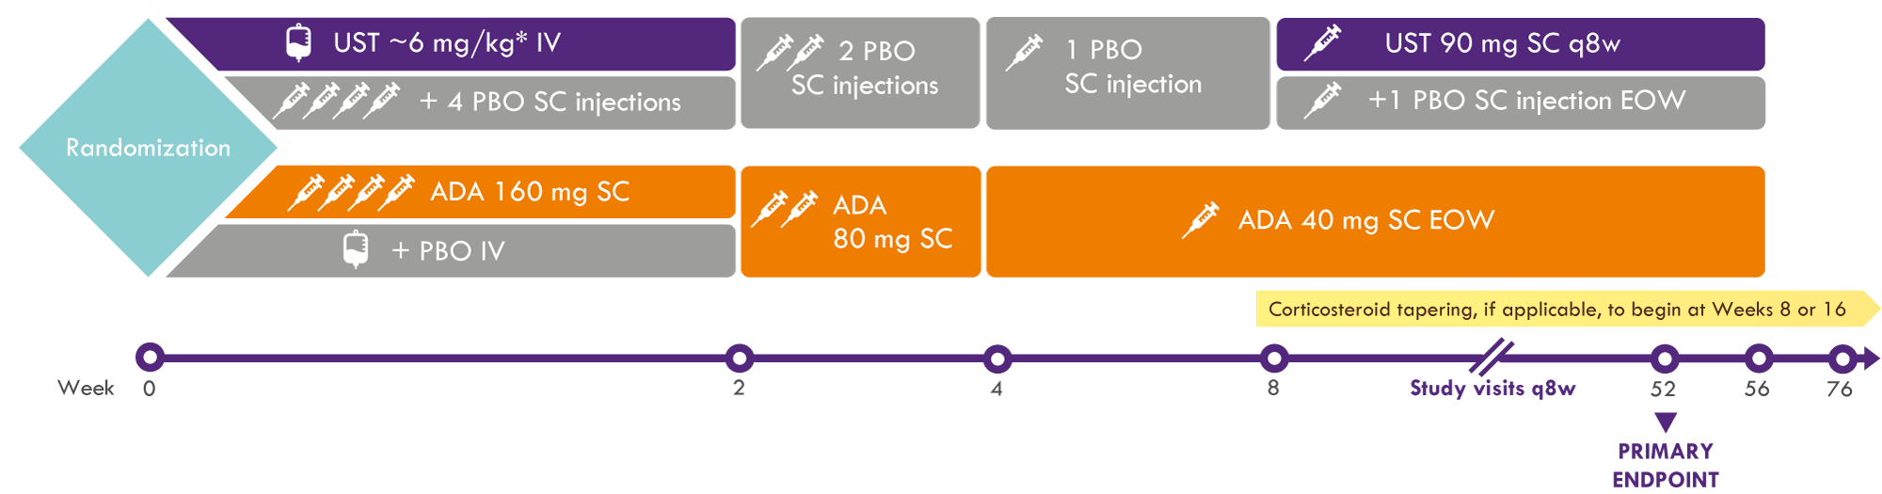
SEAVUE: Study Design^{1,2}
On-label dosing of both drugs per USPI
“New” citrate-free 40 mg/0.4 ml Humira formulation used
Target sample of 350 subjects, 386 subjects randomized
Randomization stratified by use of steroids (Yes, No), CDAI score (≤ 300 or > 300), and any ulcerations >5 mm (Yes, No) at baseline
CP-237680
Disclaimer: SEAVUE is following the US label dose. EU label dose: “The first SC administration of 90 mg Stelara should take place at week 8 after the IV dose. After this, dosing every 12 weeks is recommended. Patients who have not shown adequate response at 8 weeks after the first SC dose, may receive a second subcutaneous dose at this time. Patients who lose response on dosing every 12 weeks may benefit from an increase in dosing frequency to every 8 weeks. Patients may subsequently be dosed every 8 weeks or every 12 weeks according to clinical judgment.”
SC: subcutaneous; IV: intravenous; EOW: every other week; USPI: United States Prescribing Information
* UST 260 mg (weight ≤55 kg); UST 390 mg (weight >55 kg and ≤85 kg); UST 520 mg (weight >85 kg)
Abstract Sands et al. Ustekinumab vs. Adalimumab for Induction and Maintenance Therapy in Moderate-to- Severe Crohn’s Disease: The SEAVUE Study. https://eventpilotadmin.com/web/planner.php?id=DDW21LITE #775 Virtual DDW, 21-23 May 2021.Virtual DDW, 21-23 May 2021.
https://clinicaltrials.gov/ct2/show/NCT03464136

Slide 32
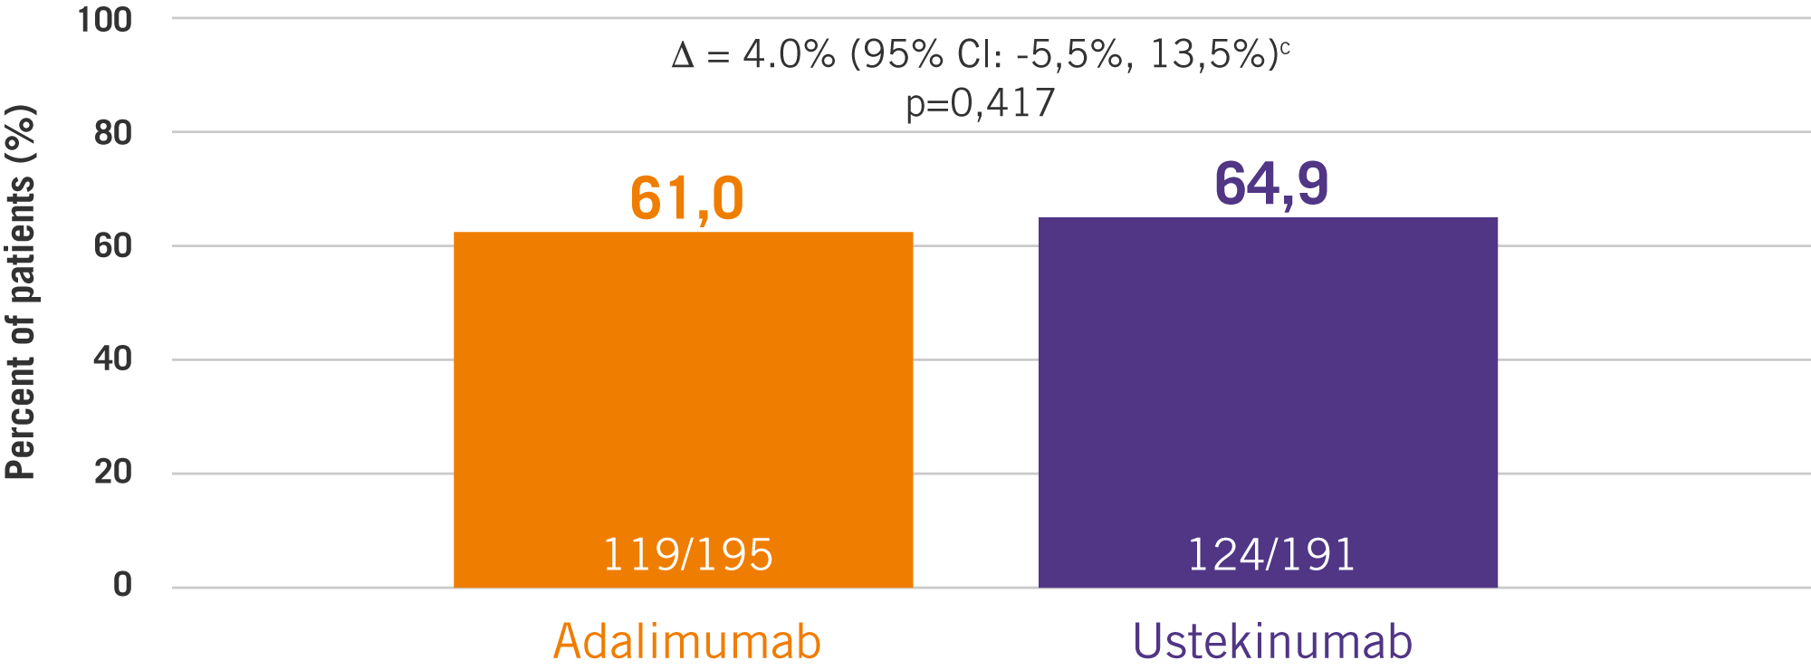
SEAVUE trial: STELARA – HIGH CLINICAL REMISSION AT 1YEAR WITH ONLY 6 SC MAINTENANCE DOSES¹
At w52, ~65% of bionaïve patients were in clinical remission with just 6 SC maintenance doses.
CLINICAL REMISSION (CDAI <150) AT WEEK 52^{a,b}
CP-237680
Disclaimer: SEAVUE is following the US label dose. EU label dose: “The first SC administration of 90 mg Stelara should take place at week 8 after the IV dose. After this, dosing every 12 weeks is recommended. Patients who have not shown adequate response at 8 weeks after the first SC dose, may receive a second subcutaneous dose at this time. Patients who lose response on dosing every 12 weeks may benefit from an increase in dosing frequency to every 8 weeks. Patients may subsequently be dosed every 8 weeks or every 12 weeks according to clinical judgment.”
ª Patients who had a prohibited CD-related surgery, had prohibited concomitant medication changes, or discontinued study agent due to lack of efficacy or due to an AE indicated to be of worsening CD prior to the designated analysis timepoint are considered not to be in clinical remission, regardless of their CDAI score.
^{b} Patients who had insufficient data to calculate the CDAI score at the designated analysis timepoint are considered not to be in clinical remission.
^{c} The confidence intervals were based on the Wald statistic with Mantel-Haenszel weight.
SC: subcutaneous
1. Abstract Sands et al. Ustekinumab vs. Adalimumab for Induction and Maintenance Therapy in Moderateto- Severe Crohn’s Disease: The SEAVUE Study. https://eventpilotadmin.com/web/planner.php?id=DDW21LITE #775 Virtual DDW, 21-23 May 2021.Virtual DDW, 21-23 May 2021.

Slide 33
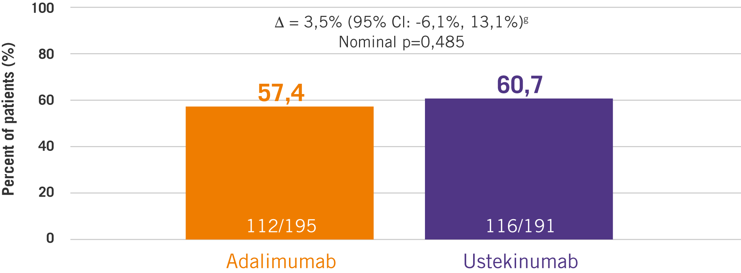
SEAVUE trial: STELARA – HIGH CS-FREE CLINICAL REMISSION AT 1 YEAR WITH ONLY 6 SC DOSES¹
SEAVUE confirms the high Corticosteroid free clinical remission with Stelara at 1 year with just 6 SC maintenance doses. In SEAVUE, >90% of bionaïve patients were in clinical remission at week 52 and were
not receiving corticosteroids.
CORTICOSTEROID-FREE CLINICAL REMISSION AT WEEK 52^{d,e,f}
CP-237680
Disclaimer: SEAVUE is following the US label dose. EU label dose: “The first SC administration of 90 mg Stelara should take place at week 8 after the IV dose. After this, dosing every 12 weeks is recommended. Patients who have not shown adequate response at 8 weeks after the first SC dose, may receive a second subcutaneous dose at this time. Patients who lose response on dosing every 12 weeks may benefit from an increase in dosing frequency to every 8 weeks. Patients may subsequently be dosed every 8 weeks or every 12 weeks according to clinical judgment.”
CS: Corticosteroid;
^{d} Patients who had a prohibited CD-related surgery, had prohibited concomitant medication changes, or discontinued study agent due to lack of efficacy or due to an AE indicated to be of worsening CD prior to the designated analysis timepoint are considered not to be in clinical remission.
^{e} Patients who had insufficient data to calculate the CDAI score at the designated analysis timepoint are considered not to be in clinical remission.
^{f} Patients who had a missing data value in corticosteroid use at designated analysis timepoint had their last value carried forward.
^{g} The confidence intervals were based on the Wald statistic with Mantel-Haenszel weight. NOTE: not receiving corticosteroids at Week 52 is defined as corticosteroid free for ≥30 days prior to Week 52.
1. Abstract Sands et al. Ustekinumab vs. Adalimumab for Induction and Maintenance Therapy in Moderateto- Severe Crohn’s Disease: The SEAVUE Study. https://eventpilotadmin.com/web/planner.php?id=DDW21LITE #775 Virtual DDW, 21-23 May 2021.Virtual DDW, 21-23 May 2021.

Slide 34
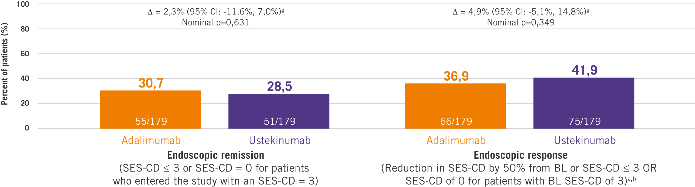
SEAVUE trial: STELARA – HIGH ENDOSCOPIC REMISSION AT 1 YEAR WITH ONLY 6 SC DOSES¹
In SEAVUE, Stelara achieved high endoscopic outcomes at 1 year, as demonstrated by the rates of endoscopic response & endoscopic remission.
CP-237680
Disclaimer: SEAVUE is following the US label dose. EU label dose: “The first SC administration of 90 mg Stelara should take place at week 8 after the IV dose. After this, dosing every 12 weeks is recommended. Patients who have not shown adequate response at 8 weeks after the first SC dose, may receive a second subcutaneous dose at this time. Patients who lose response on dosing every 12 weeks may benefit from an increase in dosing frequency to every 8 weeks. Patients may subsequently be dosed every 8 weeks or every 12 weeks according to clinical judgment.”
ª Patients who had a prohibited CD-related surgery, had prohibited concomitant medication changes, or discontinued study agent due to lack of efficacy or due to an AE indicated to be of worsening CD prior to the designated analysis timepoint are considered not to be in clinical remission, regardless of their CDAI score.
^{b} Patients who had insufficient data to calculate the SES-CD score at the designated analysis timepoint are considered not to be in endoscopic remission/response.
^{C} The confidence intervals were based on the Wald statistic with Mantel-Haenszel weight.
1 Abstract Sands et al. Ustekinumab vs. Adalimumab for Induction and Maintenance Therapy in Moderateto- Severe Crohn’s Disease: The SEAVUE Study. https://eventpilotadmin.com/web/planner.php?id=DDW21LITE #775 Virtual DDW, 21-23 May 2021.Virtual DDW, 21-23 May 2021.

Slide 35
Comment l’ustekinumab répond aux attentes d’un premier biologique dans la MC
Capacité à atteindre la cible
Sécurité et tolérance
Qualité de vie et capacité de vivre la vie souhaitée
CP-237680

Slide 36
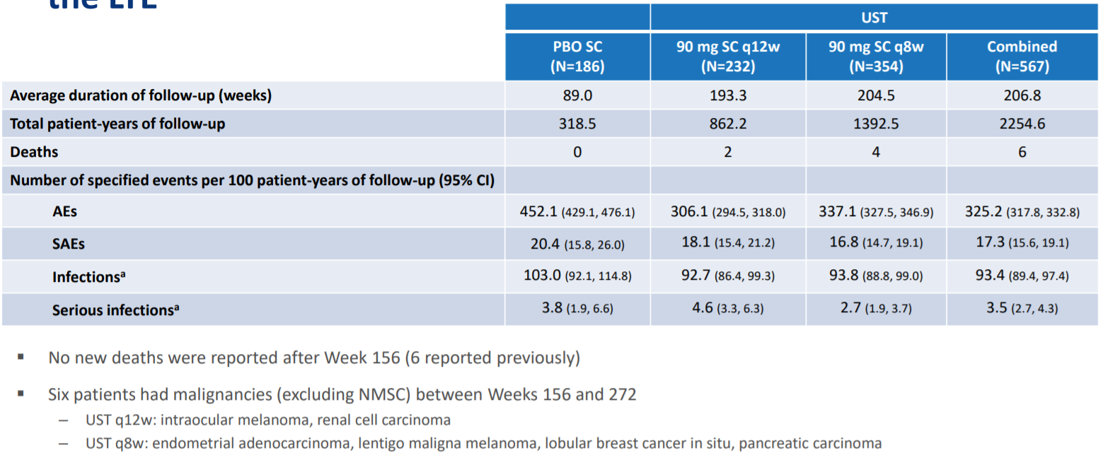
Sécurité à 5 ans avec l’ustekinumab dans la maladie de Crohn
Key safety findings through week 252: Patients who entered the LTE
CP-237680
*Infections as assessed by investigar.
Sandborn WJ et al. Five year Efficacy and Safety of Ustekinumab Treatment in Crohn’s Disease: the IM-UNITI trial, Clinical Gastroenterology and Hepatology (2021),
doi: https://doi.org/10.1016/j.cgh.2021.02.025.

Slide 37
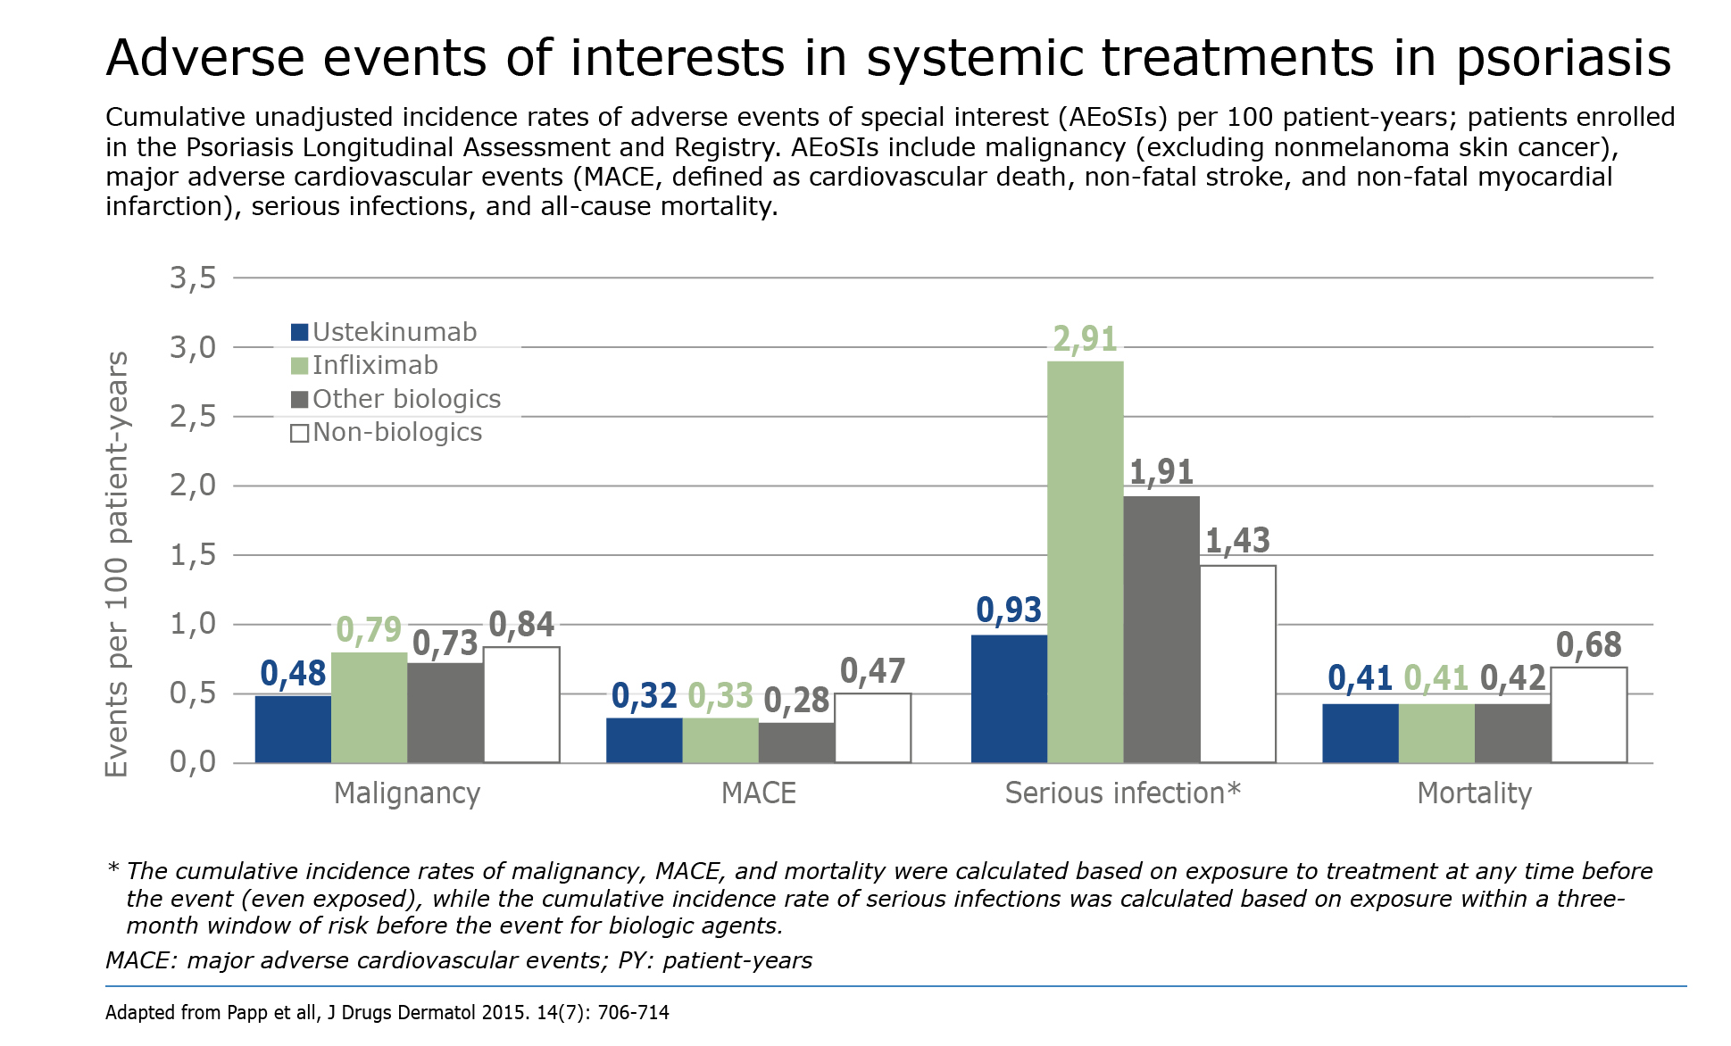
PSOLAR
CP-237680

Slide 38
Risk of infections under anti-TNF according to age
P=0,004
P<0,0006
Proportion of patients
CP-237680
Cottone M et al, CGH 2011

Slide 39
Comment l’ustekinumab répond aux attentes d’un premier biologique dans la MC
Capacité à atteindre la cible
Sécurité et tolérance
Qualité de vie et capacité de vivre la vie souhaitée
CP-237680

Slide 40
Outre le contrôle des symptômes, la qualité de vie et la capacité à mener la vie souhaitée sont associées à la prédictibilité de la réponse soutenue
CP-237680

Slide 41
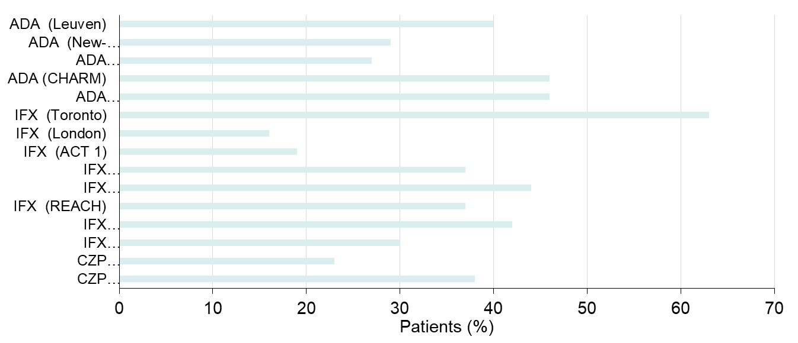
Rate of anti-TNF loss of response at 12 months (anti-TNF escalation)
CP-237680
ADA, adalimumab; CZP, certolizumab; IFX, infliximab; TNF, tumor necrosis factor.
Ben-Horin S 2010.

Slide 42
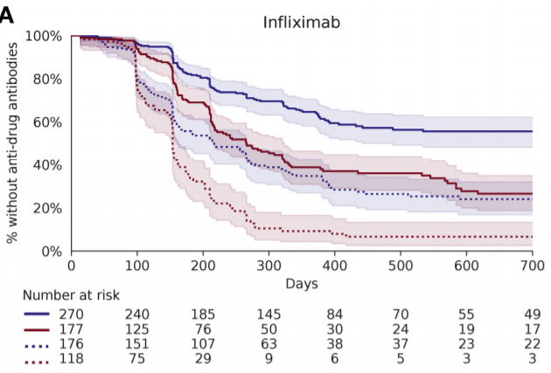
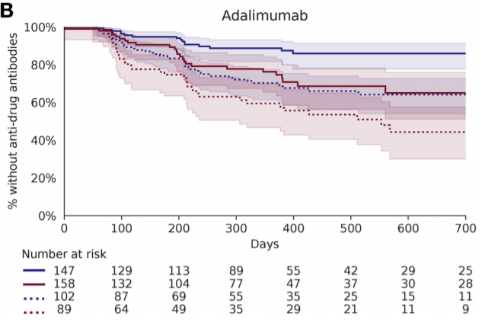
Immunogénicité, HLA-dépendante des anti-TNF
CP-237680
Sazonovs. Gastroenterology. 2020 Jan;158(1):189-199. doi: 10.1053/j.gastro.2019.09.041

Slide 43
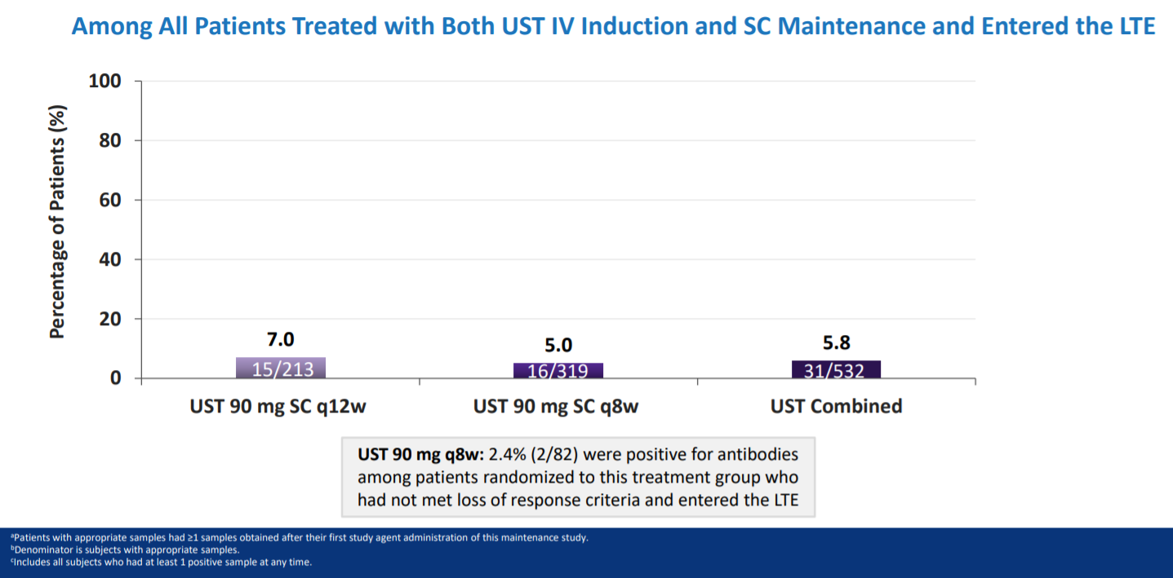
Immunogénicité à long terme avec l’ustekinumab dans la maladie de Crohn
Antibody to UST status through 5 years^{a,b,c}
CP-237680
Sandborn WJ et al. Five year Efficacy and Safety of Ustekinumab Treatment in Crohn’s Disease: the IM-UNITI trial, Clinical Gastroenterology and Hepatology (2021),
doi: https://doi.org/10.1016/j.cgh.2021.02.025.

Slide 44
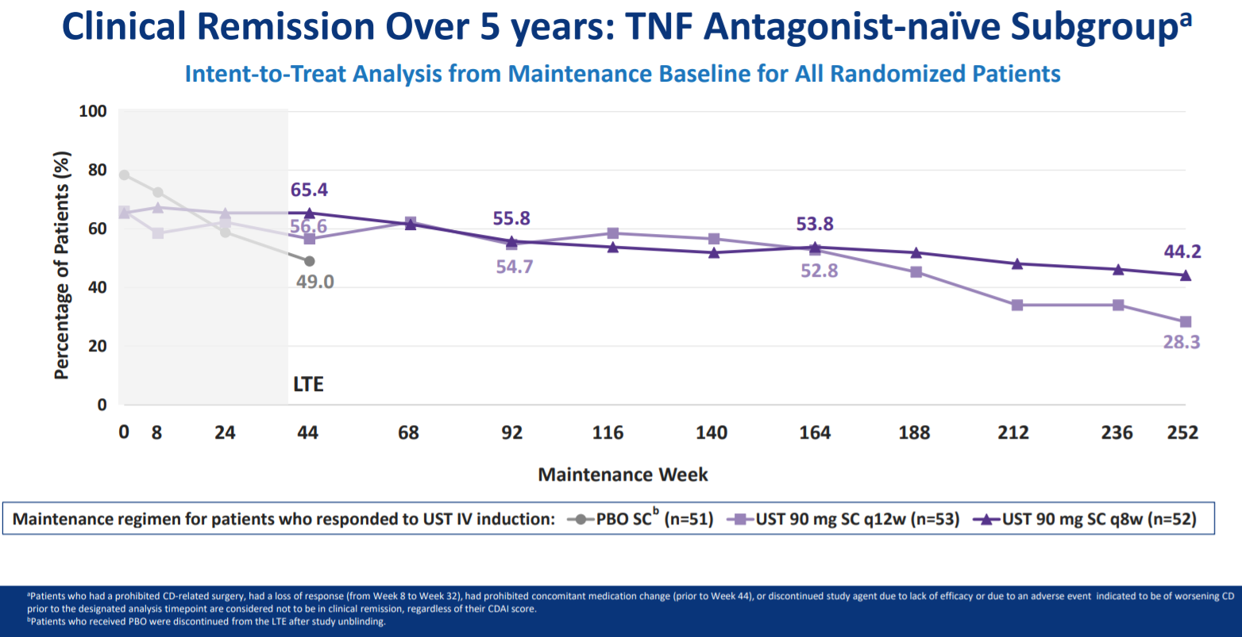
Rémission clinique à 5 ans chez les BIO-NAIFS
Clinical remission over 5 years: TNF antagonist-naïve subgroupª
CP-237680
Sandborn WJ et al. Five year Efficacy and Safety of Ustekinumab Treatment in Crohn’s Disease: the IM-UNITI trial, Clinical Gastroenterology and Hepatology (2021),
doi: https://doi.org/10.1016/j.cgh.2021.02.025.

Slide 45
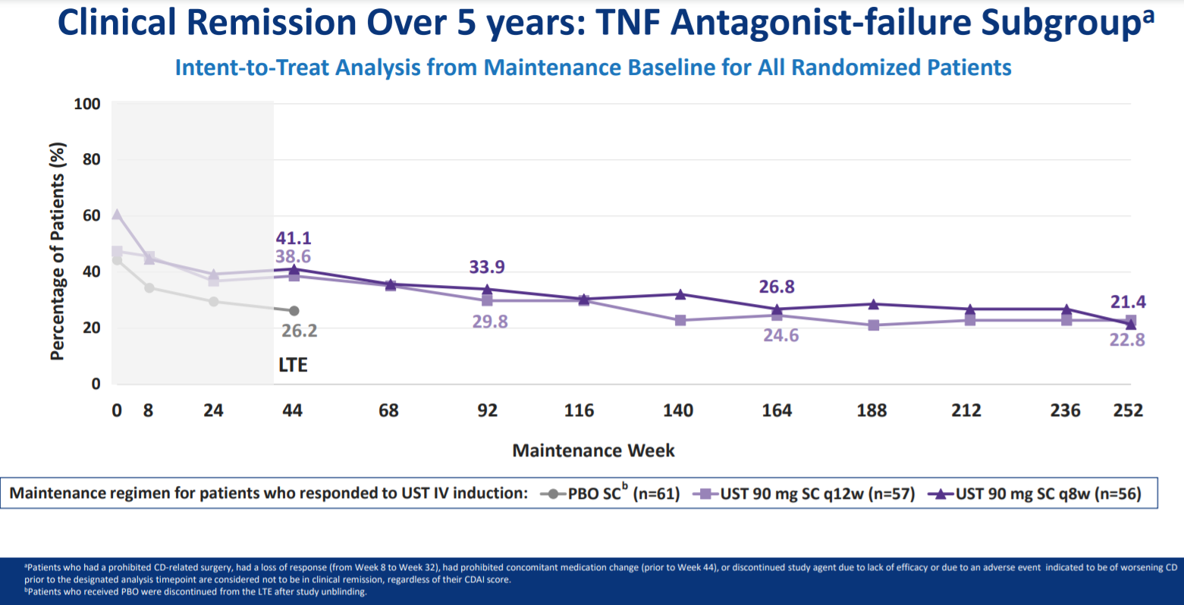
Rémission clinique à 5 ans chez les échecs d’anti-TNF
Clinical remission over 5 years: TNF antagonist-failure subgroupª
CP-237680
Sandborn WJ et al. Five year Efficacy and Safety of Ustekinumab Treatment in Crohn’s Disease: the IM-UNITI trial, Clinical Gastroenterology and Hepatology (2021),
doi: https://doi.org/10.1016/j.cgh.2021.02.025.

Slide 46
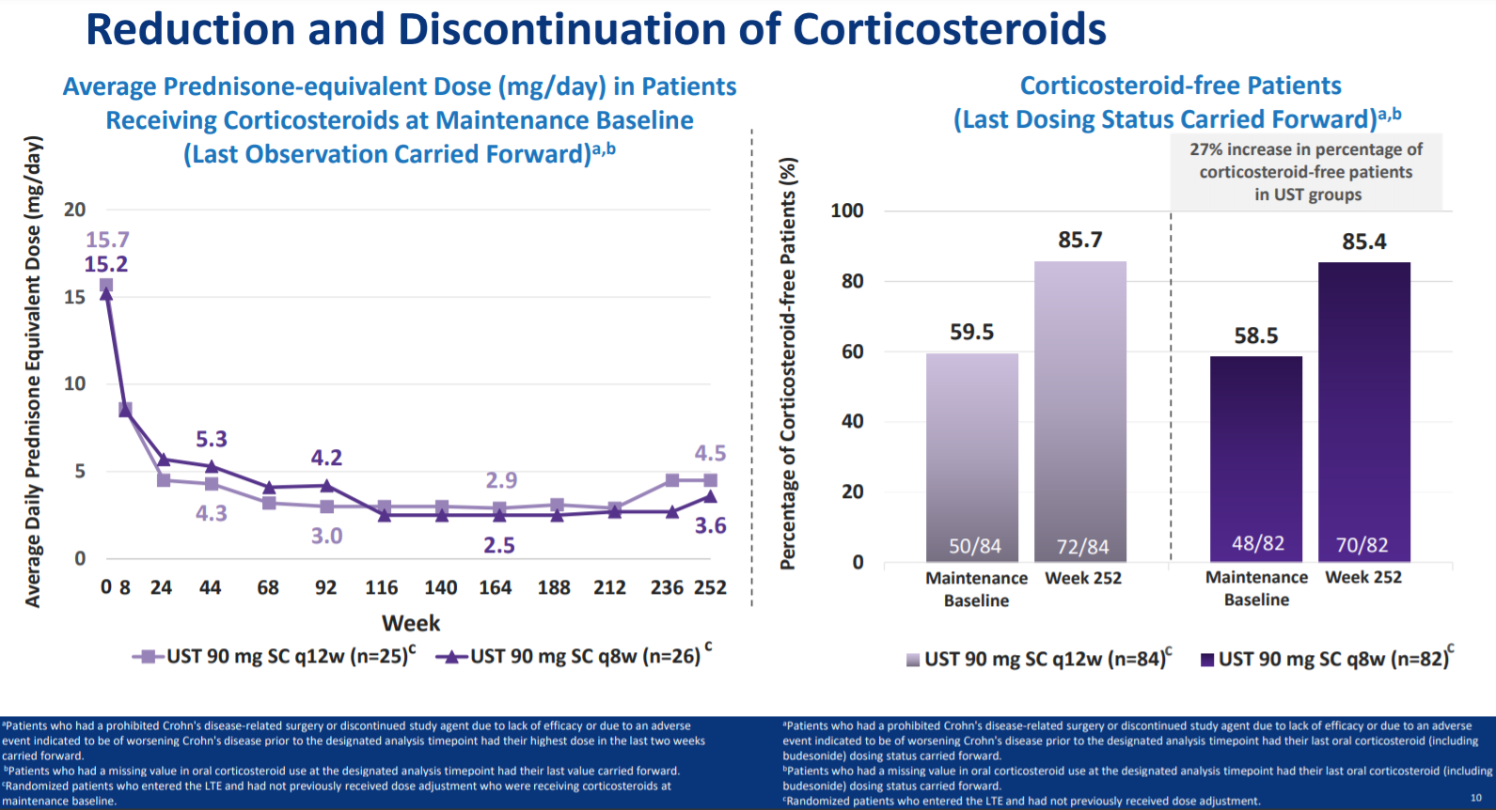
Epargne en corticoïdes avec l’ustekinumab dans la maladie de Crohn
Reduction and disconinuation of Corticosteriods
CP-237680

Slide 47
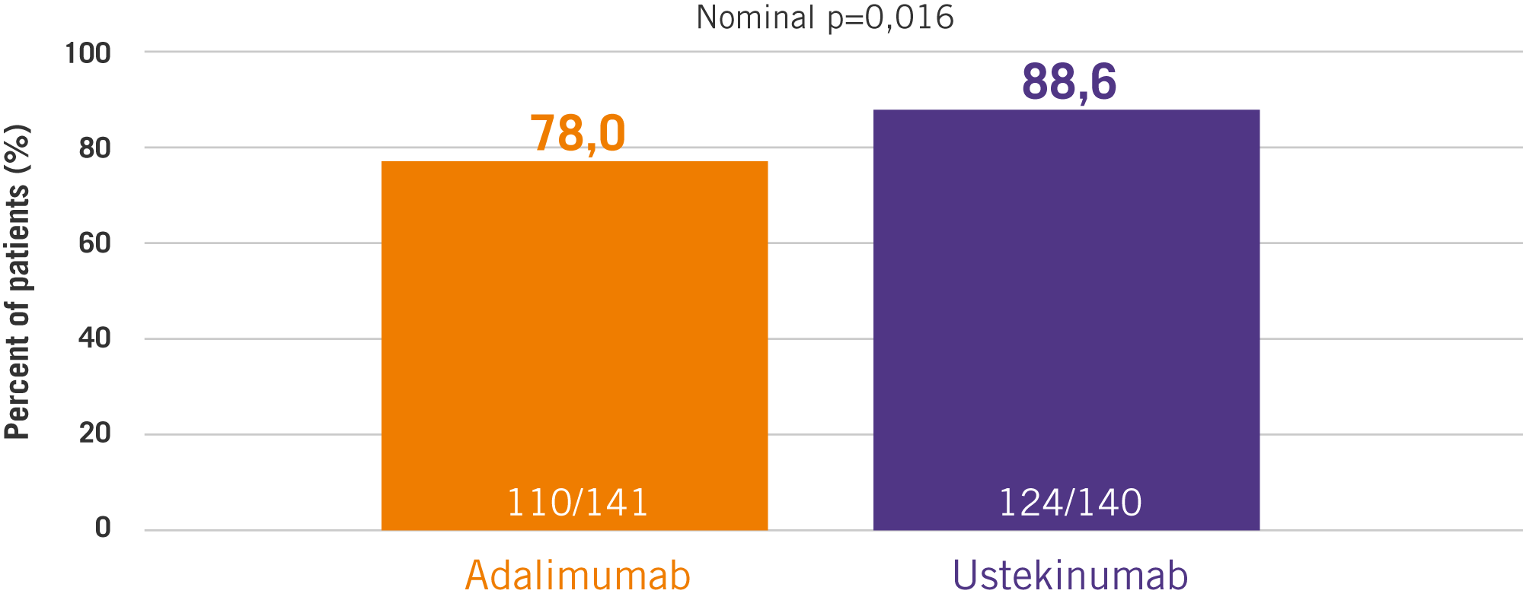
SEAVUE trial: STELARA showed EXCELLENT MAINTENANCE OF RESPONSE
89% of bio-naïve patients in response at w16 were still in response at w52¹
MAINTENANCE OF CLINICAL RESPONSE AT WEEK 52 AMONG PATIENTS IN RESPONSE AT WEEK 16^{a,b}
CP-237680
Disclaimer: SEAVUE is following the US label dose. EU label dose: “The first SC administration of 90 mg Stelara should take place at week 8 after the IV dose. After this, dosing every 12 weeks is recommended. Patients who have not shown adequate response at 8 weeks after the first SC dose, may receive a second subcutaneous dose at this time. Patients who lose response on dosing every 12 weeks may benefit from an increase in dosing frequency to every 8 weeks. Patients may subsequently be dosed every 8 weeks or every 12 weeks according to clinical judgment.”
ª Patients who had a prohibited Crohn's disease-related surgery, had prohibited concomitant medication changes, or discontinued study agent due to lack of efficacy or due to an adverse event indicated to be of worsening Crohn's disease prior to the designated analysis timepoint are considered not to be in clinical response, regardless of their CDAI score.
^{b} Patients who had insufficient data to calculate the CDAI score at the designated analysis timepoint are considered not to be in clinical response.
1. Abstract Sands et al. Ustekinumab vs. Adalimumab for Induction and Maintenance Therapy in Moderate-to-Severe Crohn’s Disease: The SEAVUE Study. https://eventpilotadmin.com/web/planner.php?id=DDW21LITE #775. Virtual DDW, 21-23 May 2021.

Slide 48
Conclusions¹
L’ustekinumab est efficace à la fois chez les patients bio-naïf et en échec de biologique
La réponse chez les patients bio-naïf est généralement plus complète, notamment sur le plan des marqueurs biologiques et de la réponse endoscopique
L’ustekinumab en monothérapie donne des résultats similaires à ceux observés avec l’adalimumab en monothérapie
L’immunogénicité et les pertes de réponses semblent plus faibles avec l’ustekinumab qu’avec l’adalimumab
La sécurité d’utilisation pourrait être supérieure avec l’ustekinumab qu’avec les anti-TNF
CP-237680
Sandborn WJ et al. Five year Efficacy and Safety of Ustekinumab Treatment in Crohn’s Disease: the IM-UNITI trial, Clinical Gastroenterology and Hepatology (2021),
doi: https://doi.org/10.1016/j.cgh.2021.02.025.

